Slide 1
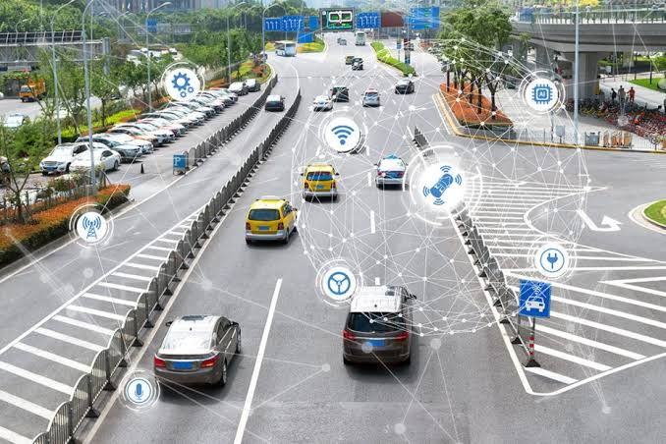
Vehicle Movement Analysis and Insight Generation in a College Campus using Edge AI
Team Name : Binary Bytes
Team Lead : Namitha C
Team Member : Preeti T L
Kalpataru Institute Of Technology,Tiptur

Slide 2
Unique Idea Brief (Solution)
This system offers thorough insights on vehicle movement and parking trends on a college campus using Edge AI.
It guarantees effective campus traffic management and security by combining vehicle movement analysis , parking occupancy monitoring.
The solution includes detecting the parking lots where it uses dataset containing vehicle occupancy and parking images, and Python libraries to monitor occupancy and identify frequently occupied parking lots.

Slide 3
Features Offered
Occupancy Detection:
The primary feature of parking slot detection systems is to determine whether a parking slot is occupied or vacant in real-time. This information is crucial for efficient parking management and can be used to guide drivers to available spots.
Accuracy and Reliability:
Systems strive to provide high accuracy in detecting occupancy status. This ensures that parking spaces are efficiently utilized and reduces the time spent searching for available spots.
Scalability:
The ability to scale from small parking lots to large multi-level parking structures is important. Systems should be adaptable to different environments and easily expandable as needed.

Slide 4
Features Offered
Object Detection
Using object detection algorithms (like YOLO, SSD, or Faster R-CNN) to identify cars or other obstacles within the parking space. This is important for understanding occupancy status and potential obstructions.

Slide 5
Dataset
Parking lot images: Includes images depicting various parking lot occupancies.
Source: [YOLOv8 Parking Space Dataset]
Vehicle Images: Includes the images of vehicles with visible plate number
Source:[Indian vehicle license plate dataset(kaggle.com)]

Slide 6
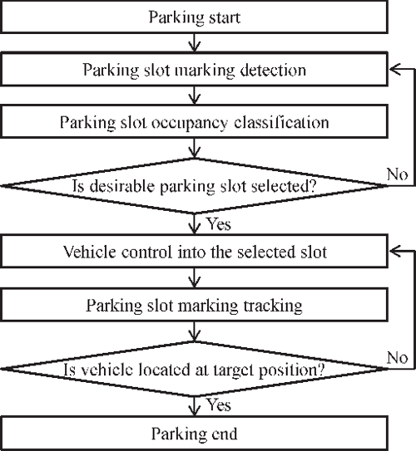
Process Flow

Slide 7
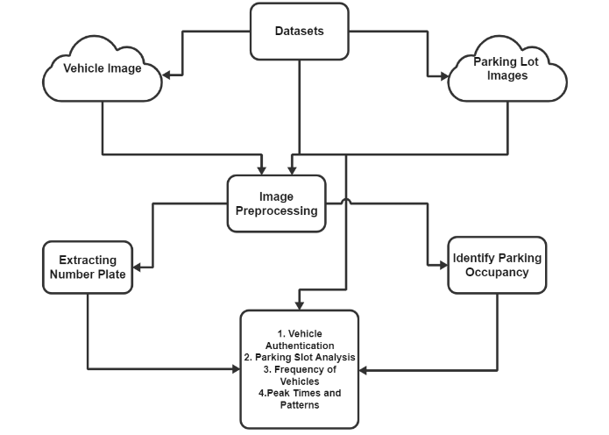
Architecture Diagram

Slide 8
Technologies Used
Python 3.10.5
VS code
YOLO (You Only Look Once)
OpenCV

Slide 9
Team Members and Contribution
Namitha C (Team Lead):
Monitored the use of YOLO algorithm.
Identified which slot has frequently occupied.
Preeti T L (Team Member):
Collected and extracted the dataset.
Coded for License plate detection and collect the data from Kaggle.

Slide 10
Conclusion
Edge AI for vehicle movement monitoring on a college campus is a game-changing tool that offers practical insights and operational efficiencies above and beyond standard surveillance. Colleges may build safer, more effective, and intelligent campus settings that benefit staff, students, and visitors by utilizing real-time data analytics at the edge.
The benefits of this method will include Improved Traffic Management, Efficient Resource Allocation and empowering Smart Campus Initiatives.
Hence this method implements a smart system to improvise and overcome the traditional parking systems.

